Slide 1
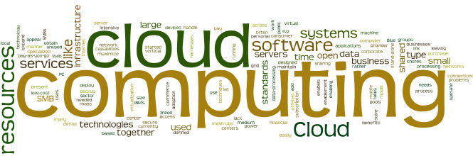
Cloud Models

Slide 2
Module Objectives
You should able to answer below questions end of this module.
Describe Cloud Deployment Models and pros & cons
Describe Cloud Service Models and pros & cons
Describe Price Models and Cloud use cases
Describe Value Models and benefits to stakeholders

Slide 3
Cloud Models
Deployment Models
Service Models
Price Models
Value Models

Slide 4
Cloud Deployment Models

Slide 5
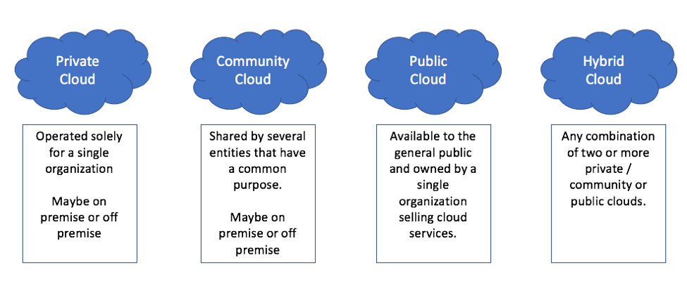
Cloud Deployment Models

Slide 6
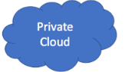
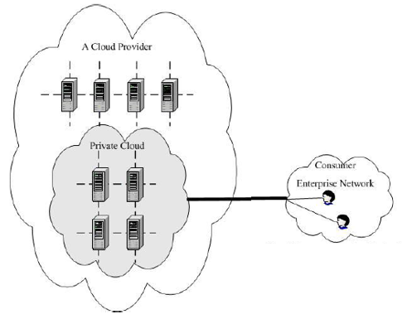
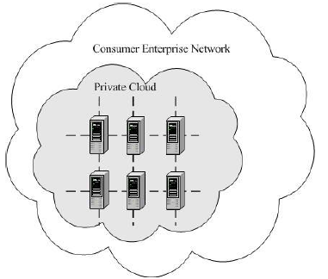
Deployment Models : Private Cloud
Off-Site (Out-Sourced) Private Cloud
The cloud infrastructure is provisioned for exclusive use by a single organization comprising multiple consumers (e.g., business units).
On-Site(On-Promise) Private Cloud
It may be owned, managed, and operated by the organization, a third party, or some combination of them, and it may exist on or off premises.

Slide 7
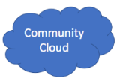
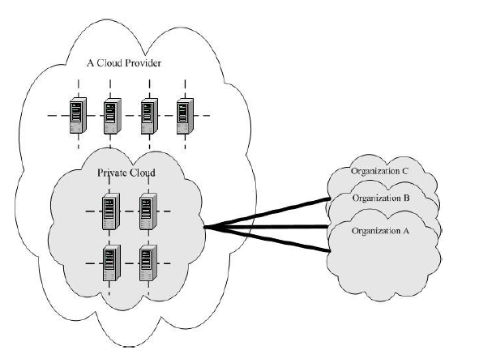
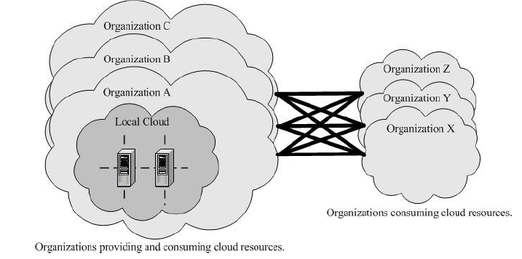
Deployment Models : Community Cloud
Off-Site (Out-Sourced) Community Cloud
The cloud infrastructure is provisioned for exclusive use by a specific community of consumers from organizations that have shared concerns (e.g., mission, security requirements, policy, and compliance considerations).
On-Site(On-Promise) Community Cloud
It may be owned, managed, and operated by one or more of the organizations in the community, a third party, or some combination of them, and it may exist on or off premises.

Slide 8
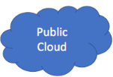
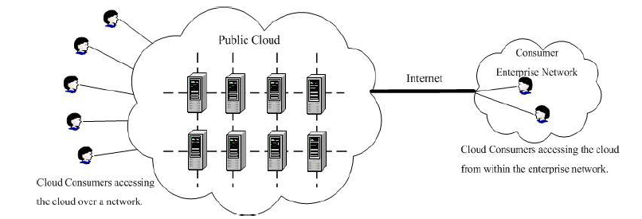
Deployment Models : Public Cloud
The cloud infrastructure is provisioned for open use by the general public. It may be owned, managed, and operated by a business, academic, or government organization, or some combination of them. It exists on the premises of the cloud provider

Slide 9
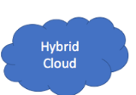
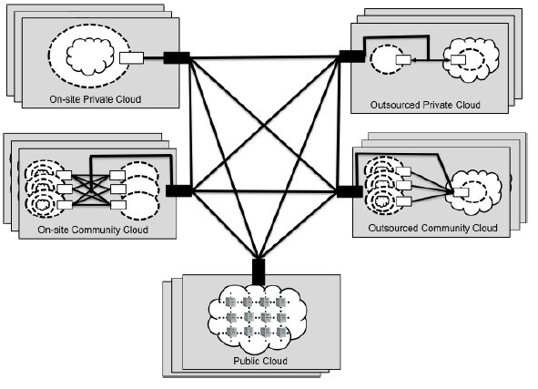
Deployment Models : Hybrid Cloud
The cloud infrastructure is a composition of two or more distinct cloud infrastructures (private, community, or public) that remain unique entities, but are bound together by standardized or proprietary technology that enables data and application portability (e.g., cloud bursting for load balancing between clouds).

Slide 10
Cloud Service Models

Slide 11
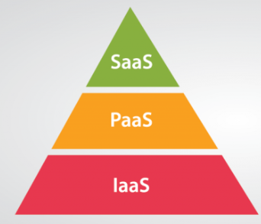
Cloud Service Models
Software as Service (SaaS)
Google Docs, Office 365,Salesforce
Platform as Service (PaaS)
Google App Engine, Cloud Foundry
Infrastructure as Service (IaaS)
Amazon EC2, Rackspace, Google Compute Engine

Slide 12
Cloud Service Models
What are these ?
Database as a Service (DBaaS)
Business Process as a Service (BPaaS)
Infrastructure as a Service (INaaS)
Everything as a Service (XaaS)
Security as a Service (SCaaS) !!
Pizza as a Service (PzaaS) !!!

Slide 13
Cloud Service Models
Not Standards
Broker solutions etc.
Database as a Service (DBaaS)
Business Process as a Service (BPaaS)
Infrastructure as a Service (INaaS)
Everything as a Service (XaaS)
Security as a Service (SCaaS) !!
Pizza as a Service (PzaaS) !!!

Slide 14
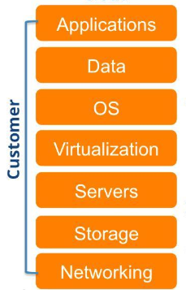
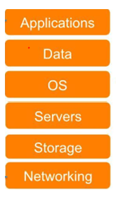
Traditional (or Private Cloud) Computing Models
You Manage
On-Promise Private Cloud
Traditional
Facility needs: HVAC , Power etc.

Slide 15
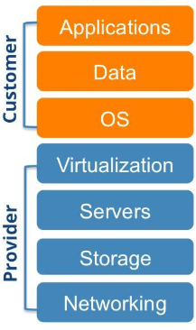
Cloud Service Models : Infrastructure as a Service
The capability provided to the consumer is to provision processing, storage, networks, and other fundamental computing resources where the consumer is able to deploy and run arbitrary software, which can include operating systems and applications.
The consumer does not manage or control the underlying cloud infrastructure but has control over operating systems, storage, and deployed applications; and possibly limited control of select networking components (e.g., host firewalls).

Slide 16
Cloud Service Models : Infrastructure as a Service
Benefits of IaaS
Cost effectiveness: Instead of companies having to spend a bunch of money on IT infrastructure or hardware to house their data, they can use the IaaS platform to develop and access their applications and data. Most importantly, they pay as they go, which this leads to a significant reduction in costs as organizations pay only for the services they need..
Versatility: Since users can access their IaaS platforms through an internet connection, it makes accessing their applications and data easier. It also gives companies collaboration tools when they work with satellite offices or employees around the world.
Sustainability: For environmentally minded businesses, IaaS platforms represent the best solution. Since companies can access everything virtually, it reduces carbon emissions, especially when compared to the traditional model of housing everything through hardware.
Improved productivity: Since companies don’t have to spend time maintaining new applications, IT administrators have more time to develop new applications.

Slide 17
Cloud Service Models : Infrastructure as a Service
IaaS Drawbacks
Security: This is the biggest concern; companies trust their sensitive data to cloud service providers. While providers can offer a range of solutions to ensure that an organization’s data remains secure
Technical problems: While businesses won’t have to worry about maintaining their platforms with IaaS, they may still experience some downtime. This downtime will restrict their access to data and applications. Additionally, since access to the platforms is dependent upon internet access, companies that have employees in remote areas where reliable internet access isn’t always available may have trouble accessing the platform.
Lack of flexibility: Service providers maintain the software, and they may not update to new versions quickly enough for some businesses.

Slide 18
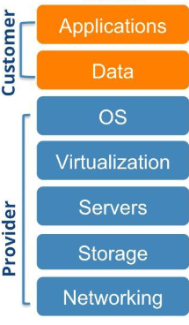
Cloud Service Models : Platform as a Service
The capability provided to the consumer is to deploy onto the cloud infrastructure consumer-created or acquired applications created using programming languages, libraries, services, and tools supported by the provider.
The consumer does not manage or control the underlying cloud infrastructure including network, servers, operating systems, or storage, but has control over the deployed applications and possibly configuration settings for the application-hosting environment.

Slide 19
Cloud Service Models : Platform as a Service
Benefits of PaaS
Cut development time: PaaS offerings usually provide pre-coded application components for faster programming such as application search and workflow, security, and directory services.
Cost savings: End-users save money by offloading hardware, software, and programming purchases to the service provider. And since development is faster, businesses can avoid the extra expense of new programmers and IT admins.
Faster cross-platform and mobile development: Some PaaS providers build their environments around mobile application development, and/or cross-platform portability. This makes mobile and cross-platform apps quicker and easier to develop and upgrade.
Flexible and affordable services: End-users can choose the features they want on a pay-as-you-go basis including advanced programming and analytics tools.
Geographically distributed teams: Remote teams can work together using the same development environment, and development can run 24x7 if development teams are in multiple time zones.

Slide 20
Cloud Service Models : Platform as a Service
Benefits of PaaS
Efficient development lifecycle: PaaS environments provide full lifecycle services including application programming, testing, deploying, managing, hosting, and updating.
Innovation: High costs of computing infrastructure and programming tools can stymie development innovation and experimentation. Cost-effective PaaS encourages innovative development teams.
Scalability: Extremely scalable cloud infrastructure enables PaaS developers to rapidly provision computing infrastructure, and to offer high performance cloud applications to massive end-user communities.

Slide 21
Cloud Service Models : Platform as a Service
When you work with PaaS Vendor ;
When you are looking for a PaaS provider, first ask them all the questions that you need to ask any cloud computing provider around performance, scalability, service level agreements, security, and reliability.
Ask PaaS vendors additional questions around development environment customization,.
automation, flexibility, and support
Customization. Customizing the PaaS stack can make or break the development team’s success. Some level of customization is implicit in the PaaS offering because the users can choose the components that work for them.
Flexibility. Flexibility becomes a big concern when a team wants to be platform independent, or avoid vendor lock-in.
Support. Customer service and support are fundamental to successful PaaS agreements. Many development teams prefer a self-service portal, but also need to do due diligence around support services. Some questions to ask include the support engineers’ level of expertise, how long it takes to escalate an incident, and extra costs.

Slide 22
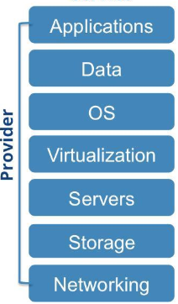
Cloud Service Models : Software as a Service
The capability provided to the consumer is to use the provider’s applications running on a cloud infrastructure. The applications are accessible from various client devices through either a thin client interface, such as a web browser (e.g., web-based email), or a program interface.
The consumer does not manage or control the underlying cloud infrastructure including network, servers, operating systems, storage, or even individual application capabilities, with the possible exception of limited user-specific application configuration settings.

Slide 23
Cloud Service Models : Software as a Service
Benefits of SaaS
The reasons for the popularity of the Software as a Service model, offered from the cloud, is that it offers some valuable benefits, the most important of which are:
Reduced capital expenditure and predictable operational expenditure: Companies access Software as a Service in return for a monthly fee, so they pay for the software as they use it. Since it is the responsibility of the SaaS provider to purchase and maintain all the infrastructure required to run the application, companies that adopt SaaS can avoid the large up-front capital outlays on hardware and software licenses associated with running applications on-premise. Instead SaaS customers fund their software usage with predictable monthly operational expenditure.
Scalability: Software as a Service providers operate out of clouds with resources that are practically unlimited, enabling customers to scale their software usage almost indefinitely. That means that customers can pay for what they need: if they need to add users as they grow, or following an acquisition, they can do so almost instantly without worrying about resource capacity or needing to think about over-provisioning resources to allow for possible further expansion.

Slide 24
Cloud Service Models : Software as a Service
Benefits of SaaS
Flexibility: Implementing a new application takes most businesses many months and involves purchasing and installing hardware, installing the software, implementing backup and disaster recovery procedures, testing, and rolling the software out to users. By contrast users can be up and running with SaaS applications in the cloud in a matter of hours.
More efficient software management: A Software as a Service provider running its software in the cloud can often manage its product on behalf of all its customers much more efficiently than individual companies running their own instances of an application in-house. That's because of economies of scale and because the SaaS provider builds up expertise running its own software.
SaaS customers also enjoy the benefits of software that is automatically updated with bug fixes and security patches – and upgraded periodically to include new features – without the need for any action on their part.
A side-benefit of this is that corporate IT staff can be freed from the often tedious and time-consuming tasks of maintaining software and carrying out upgrades to work on more productive IT tasks.

Slide 25
Cloud Service Models : Software as a Service
Benefits of SaaS
Accessibility: Since SaaS applications are accessed over the Internet, that means that users can access the software from anywhere, using anything from an office PC to a tablet or smartphone. And because data is stored in the cloud that also means that there are no data synchronization issues: mobile workers can use the most up-to-date data, and any data that they enter is immediately available to all other corporate users.
Resilience: Since SaaS applications are hosted in the cloud, along with the associated data, that means that in the event of a disaster at a customer's premises the application and data will be unaffected and still be accessible from a backup location or via mobile devices.

Slide 26
Cloud Service Models : Software as a Service
SaaS Drawbacks
Despite the popularity of the SaaS model, there are some significant drawbacks that are more significant to some potential customers than to others. These include:
Security risks: Using SaaS applications necessarily involves moving data outside the corporate network and entrusting it to a third party. Although there are security standards that SaaS companies have to adhere to, and arguably they are likely to have more expertise and resources to dedicate to cloud security, entrusting data to a third party involves some risk.
Poor Performance: Since SaaS applications rely on a connection between the end-user and the cloud, it may be that insufficient bandwidth is available for the desired number of people to access Software as a Service with acceptable performance.
Difficulty integrating with other applications: Many applications run by businesses share data with other applications that the company uses. But if an application is run in the cloud that can make it harder for integrations to be carried out with applications run on-premise, or with other SaaS apps running in the cloud. The good news is that integrating SaaS applications is not nearly as hard as integrating on-premise applications, because they have usually been designed with exposed APIs for integration. Tools from vendors including Jitterbit, Dell Boomi, SnapLogic, Mulesoft, are available to build integrations that are not already built in to SaaS applications.

Slide 27
Cloud Service Models : Software as a Service
SaaS Drawbacks
Data availability and downtime worries: Any time data is stored outside the corporate network there is a danger that it will be inaccessible due to a service outage at the SaaS provider's cloud – although arguably this is likely to occur less frequently than an application outage in a corporate data center. A more serious problem is that a Software as a Service provider could go out of business, taking all the data with it.
A related problem is that Software as a Service customers risk being "locked in" to their SaaS provider if the provider does not have practical provisions in place for customers to retrieve their data or move it to an alternative SaaS provider within a reasonable timeframe and at a reasonable cost.
Lack of access to open source code: There are many benefits to using open source applications, including the ability to alter the code to suit particular needs. But when open source applications are accessed from the cloud using the SaaS model companies no longer have the capability to alter the source code, and are instead reliant on the SaaS provider carrying out customizations on the code that is offered as a service.

Slide 28
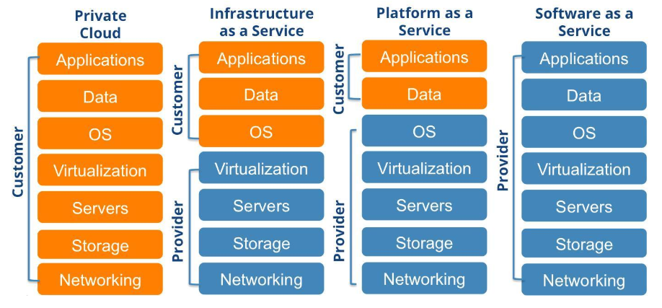
Cloud Service Models
Source: saveone.com

Slide 29
Cloud Service Models : Users
Software as Service (SaaS)
End User ,thin client/remote users
Platform as Service (PaaS)
Application Developer
Infrastructure as Service (IaaS)
System , Network Admins &Architects

Slide 30

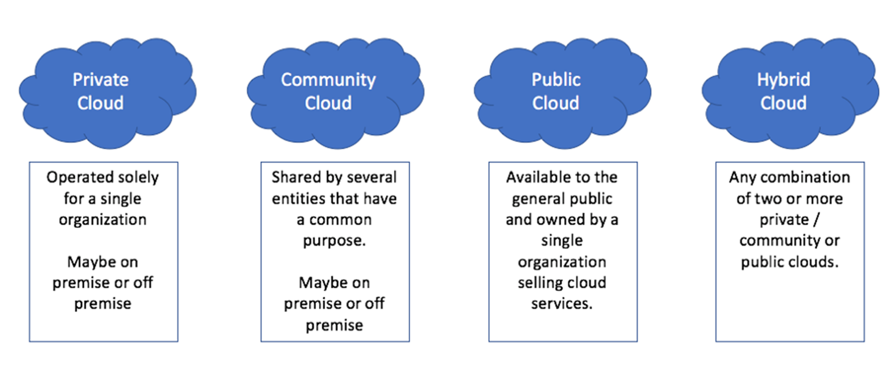
Summary : Service Models &Deployment Models
Cloud Service Models
Cloud Deployment Models

Slide 31
Price Models

Slide 32
Price Models
There are a variety of price models in existence let’s categorize them in five main model.
Utility Price Models
Service Based Models
Performance Based Models
Marketing Oriented Based Models
Hybrid Models
$

Slide 33
Price Models : Utility Based (1/4)
Utility models are metered price models whereby your usage of the service is monitored and you pay accordingly Originating from the price plans that utility companies have adopted, they are characterized by regular payments,
often monthly, to the cloud service provider.
Three utility price models are :consumption, transaction, and subscription based price models.
Consumption-Based Price Model The consumption price model is a commonly used model for IaaS and PaaS. You pay for the computing resources that you use, for example, amount of storage (in Megabytes or Gigabytes), computing or processing power (in terms of CPU cycles or number of processor cores used), and memory (in Megabytes or Gigabytes). An average consumption rate of these resources is computed over a day, week, or month and you pay for the average utilization.
Notes:
AWS Pay-as-you-go
Pay-as-you-go allows you to easily adapt to changing business needs without overcommitting budgets and improving your responsiveness to changes. With a pay-as-you-go model, you can adapt your business depending on need and not on forecasts, reducing the risk of overprovisioning or missing capacity.

Slide 34
Price Models : Utility Based (2/4)
Transaction-Based Price Model Transaction-based pricing uses transactions, instead of computing resources as the basis for pricing. The transactions can be business related, such as invoices processed .You can also have transaction-based pricing with IaaS and PaaS, for example, by using the bandwidth as an indicator of computing resource utilization; thus, a consumption based price model can be converted to a transaction-based model by assessing the bandwidth used by each transaction.
Subscription-Based Price Model Similar to the all-you can-eat model, the subscription price model is when you pay a price, usually monthly, in order to use a service. For example, when you subscribe to a magazine, you pay a regular fee regardless of whether you actually read all of it, some of it, or none of its articles. If you no longer need the service you would need to provide a notice beforehand. Subscription pricing can be used well for all cloud deployment models.

Slide 35
Price Models : Service Based (3/4)
Service models use the benefit delivered to you, such as the SLA realized, risk transfer, or money saved, as the criteria for defining the price you pay for the cloud service.
Three service based price models are :fixed ,volume and tiered based price models.
Fixed Price Model The price that you pay for this service is fixed on a yearly, quarterly, or monthly basis. The fixed price can be made up of two components: recurring and nonrecurring prices. The latter is a one-off amount that you pay at the outset followed by recurring payments at regular intervals. The fixed price model is generally chosen when you have a clearly defined scope that is aligned to your short-term goals

Slide 36
Price Models : Service Based (4/4)
Volume-Based Price Model Volume can relate to the number of users, amount of storage space, speed of different price tiers for them, with each SLA tier providing greater benefits to you.
Tiered Price Model The tiered price model uses a tiered form of pricing that is based on SLAs, volume, or amount spent. It is similar to the tiers that airlines have for their membership levels that are determined by the amount you spend on travel with the airline. With cloud computing a similar form of tiered pricing can apply with greater discounts provided that you spend a certain amount each year. Alternatively, you could have tiers based on the SLAs such that the more stringent the SLAs, the more you pay. For example, there could be three SLA tiers and three different price tiers for them.
Notes:
AWS Pay less by using more ( volume based)
With AWS, you can get volume based discounts and realize important savings as your usage increases. For services such as S3, pricing is tiered, meaning the more you use, the less you pay per GB. AWS also gives you options to acquire services that help you address your business needs.
AWS Save when you commit ( Tiered)
For AWS Compute and AWS Machine Learning, Savings Plans offer savings over On-Demand in exchange for a commitment to use a specific amount (measured in $/hour) of an AWS service or a category of services, for a one- or three-year period.

Slide 37
Price Models : Performance Based (1/2)
Performance models are benchmark-based models that rely on key metrics, or benchmarks, to decide the price paid. Most performance models originate from employee remuneration or outsourcing related price strategies but can be applied to cloud computing, especially to a private or hybrid cloud service. Sometimes these models are used to align your business goals to those of your service provider’s goals in order to create a true partnership.
Three service performance price models are :outcome , business-linked and gain-share based price models.
Outcome-Based Price Model If your department wants to use cloud computing because it wants to reduce time to market (this being one of the seven value models) then you may want to negotiate a “bonus” payment to the cloud service provider that is linked to that outcome. Most outcomes use metrics that relate to cloud computing’s value proposition, as expressed by the value models that we consider in the next section.

Slide 38
Price Models : Performance Based (2/2)
Business-Linked Price Model Whereas outcome based models use metrics that measure the value of cloud computing, business-linked models measure the contribution that cloud computing makes to the KPIs that affect your business model. ( all outcomes should match the KPI metrics)
Gain-Share Price Model The gain-share model has its roots in employees’ remuneration schemes. The idea is that as the organization gains, it shares some of those gains with its employees. A typical gain-sharing organization measures its own performance and shares the profits with all its employees using a predetermined formula.
The organization’s actual performance is compared to its historical average (known as its standard or baseline In a cloud computing context, instead of having penalties should certain SLAs not be met, you reward the service provider by sharing your profits if the SLAs are exceeded.

Slide 39
Price Models : Market Oriented Based (1/2)
Certain price models are driven by marketing rather than performance. The key driver behind such models is to attract as much custom as possible and to then monetize it to create a profit.
Two market oriented price models are : freemium, razor-and-blade based price models.
Freemium Price Model There are two types of freemium.
One is where you try before you buy a more enhanced service,
Second the other type is where you get a free service but the advertisements provided to you make up for the service’s price.
This model is especially suited to SaaS because many software companies such as LinkedIn and Dropbox use it well. They offer a free version of their product that has limited functionality but provide you the option to pay for a premium service with extra features. The idea is to offer enough value to users in the free version in order to attract and retain them, and more value in the enhanced version to ensure that the users convert and maximize the service provider’s revenue.

Slide 40
Price Models : Market Oriented Based (2/2)
Razor-and-Blades Price Model This pricing model relies on two components, a base component and a reusable component that the base component needs in order to deliver a service. It is akin to selling you razors cheaply, or even giving them away for free, and then making up for it from the prices of the consumable blades.
Printers are another example; they are sold cheaply, but the price is made up from the printer ink supplies. In cloud computing, a device or an app that uses a cloud service may be given away, but the price may be made up from the data that is stored, analyzed, and presented by the cloud service.
For example, you could have a blood pressure monitor that sends data automatically to a cloud service.The cloud service would then store and analyze the data, which it would use to alert you if a certain blood pressure level were traversed.

Slide 41
Price Models : Hybrid
The utility, service, and performance price can be combined to produce hybrid price models. For instance, you could have a subscription-based system that utilizes a tiered approach. If the dollar spend per annum were to be at a certain level, then that level would decide the discount tier that would apply to you.
One other approach would be to combine the risk transfer of the fixed model with the affordability of one of the utility price models to provide a fixed, monthly, price to the user such that they may consume as much of the service as they wish for that fixed monthly fee.
This type of hybrid price model is quite common to many public cloud services such as Google docs and Microsoft Office 365.

Slide 42
Value Models

Slide 43
Value Models
In various disciplines, different types of value models exist. Just to name a few, there are the user expectancy value model, the place value model, and the customer value model. For our purposes in cloud computing, however, a value model is a standard pattern that defines value to you, as a user of cloud computing, and that is common to a number of users in similar situations.
Operation Expense
User Demand Flexibility
Agility for Time to Market
Location Flexibility
Asset Optimization
Profit Margin
Price Flexibility

Slide 44
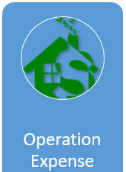
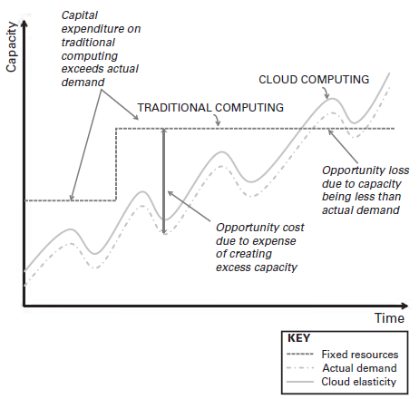
Value Models : Operation Expense
In order to provide a computing service, your IT department would need to spend capital up-front in order to create and maintain the service. And for that service to remain within the bounds of your SLAs, the
IT department would need to create extra capacity.
All this capital expenditure represents an opportunity cost
to you as the capital could have been employed elsewhere
to pursue a business opportunity.
Conversely, should the actual demand exceed the compute
Capacity that you have invested capital in, the extra demand
will either not be met or will translate to degraded SLAs.
The end result will be an opportunity loss to your business,
since the unmet demand will cause loss of business to you.
Notes:
Opportunity cost : the loss of potential gain from other alternatives when one alternative is chosen.
Opportunity lost : The value of a lost chance or a potential profit that was not realized because a course of action was taken that did not permit the investor to obtain that profit.

Slide 45
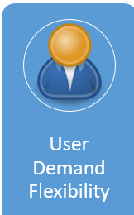
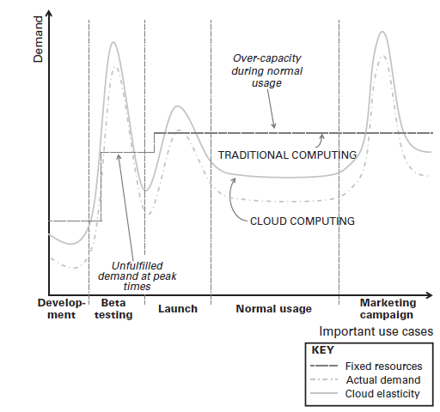
Value Models : User Demand Flexibility
Every product or service that your business provides to your customers has a life cycle that comprises of development, testing, launch, marketing and normal business usage.
During each of these phases, differing demands are
placed upon computing so that you will have periods
Consisting of peaks and troughs over the entire life cycle.
To ensure that you meet all these demands, you will need to
invest and disinvest in overprovisioning compute capacity.
In any case, there will inevitably be periods where the
demand will simply be unmet—especially during product
launches and marketing drives
Elasticity to ensure that the various demands on computing
during your product’s life cycle will be met on an as-needed
basis.

Slide 46
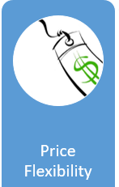
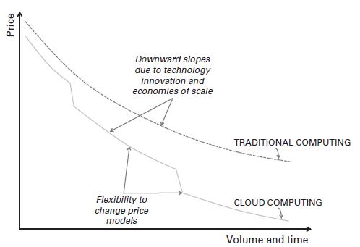
Value Models : Price Flexibility
Over time the general trend in price for computing—regardless of whether it is traditional or cloud computing— is downward. This is because of newer technologies coming onto the scene at a fast pace and on a regular basis.
Another contributing factor to the downward trend is the economies of scale resulting from the adoption of new technologies as the older ones reach obsolescence. Cloud computing gives you the ability to further introduce a step change to the downward price curve by using different price models as your needs and volume requirements change.
For instance, at lower volumes, a consumption price model might be optimum for you, whereas a performance price model might be more suitable at higher volumes.
Different price models to lower computing costs over time as demand, volume, and circumstances change. Tiered and hybrid models are examples where the cloud service provider takes advantage of this to offer you greater discounts with increases in volume.

Slide 47
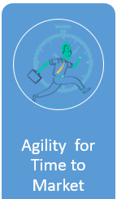
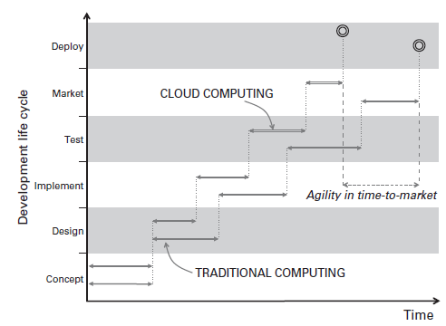
Value Models : Agility for Time to Market
The time-to-market value model of cloud computing, reduces your time to go to market by enabling you to transition from one computing environment to another at a faster pace. This is because you do not have to spend time commissioning computing infrastructure and environments, you can have any number of computing resources available to you to use in order to deploy your business application or service.

Slide 48
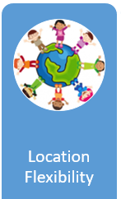
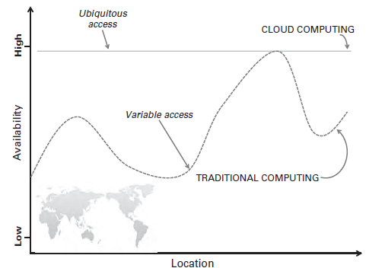
Value Models : Location Flexibility
The location flexibility value model enables you to access your computing environment and work from any location due to the ubiquitous nature of computing.
This flexibility increases your productivity and empowers you to have global reach.

Slide 49
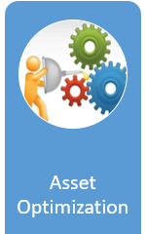
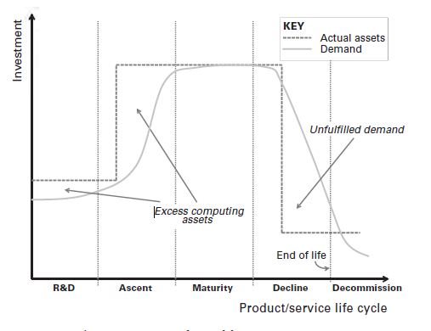
Value Models : Asset Optimization
The asset optimization value model is similar to the demand flexibility value model except that the perspective is different. In the demand flexibility model the unmet demand over a product life cycle resulting in loss of business, with this option we should consider the extra investment we will need to make in order to have excess capacity in order to prevent loss of business.
Or, rather, loss of reputation should your business be impeded due to lack of computing capacity.
Additionally, when nearing end-of-life of your service, you are left with extra computing infrastructure that takes up needless space and so acts as a drain upon your cash flow. All this assumes that the asset life cycle that affects investment follows the product life cycle. So you can optimize your assets through the use of cloud computing.

Slide 50
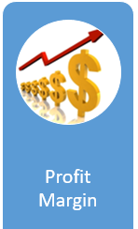
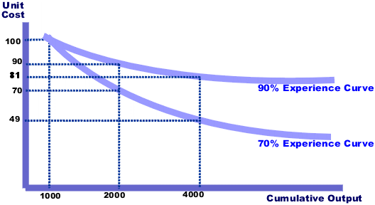
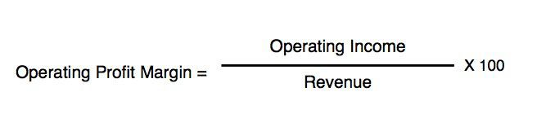
Value Models : Profit Margin
When you produce any good or service, value-added costs (including overheads) fall by about 25 percent every time the cumulative volume, or your accumulated experience, doubles.
This results in a downward-sloping price curve that increases your profit with experience, and this price curve is known as the experience curve.
Cloud computing is an evolutionary, though revolutionary in terms of its application, change to traditional computing as it draws on computing’s cumulative experience. As such, it represents a shift in traditional computing’s experience curve to the right. This moves the break-even point for using an outsourced cloud computing service, thus increasing your profit margin further.
In fact one of cloud computing’s value proposition is that it increases your profit margin

Slide 51
Cloud Service Level Agreements (SLA)
Service providers define certain performance(s) per their service/product and guarantees them for users.
The typical SLA metrics include memory size, CPU speed/frequency, CPU type (e.g., CPU or graphics processing unit ) storage size, network bandwidth, response time, system uptime, and packet loss.
An ideal SLA should contain the following :
A set of services the provider will deliver
A complete, specific definition of each service
The responsibilities of the provider and the user
A set of metrics to determine whether the provider is delivering the service as promised, such as throughput, reliability, durability, elasticity, linearity, automation, and user service response times
An auditing mechanism to monitor the service
The remedies available to the user and provider if the terms of the SLA are not met
How the SLA will change over time

Slide 52
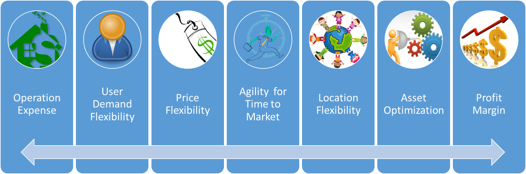
Summary : Price and Value Models
Utility Price Models
Service Based Models
Performance Based Models
Marketing Oriented Based Models
Hybrid Models
Price Models
Value Models

